Slide 1
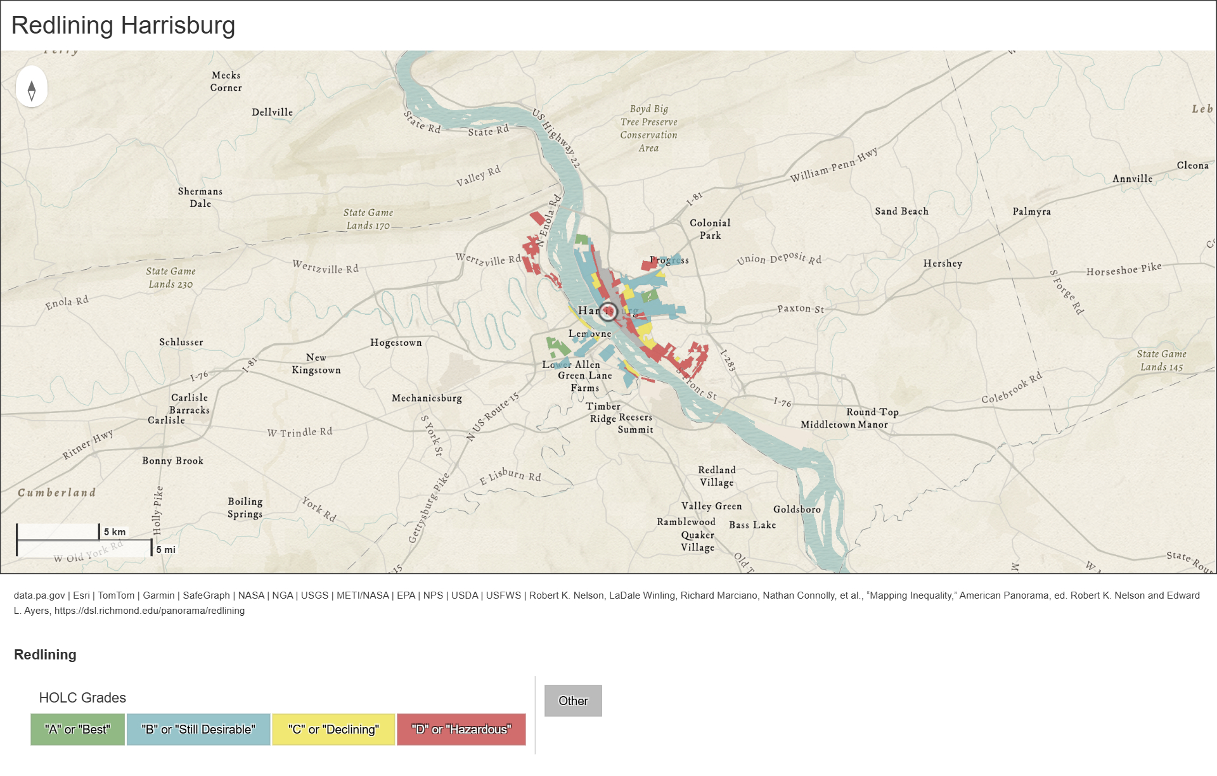
Urban Heat Islands in Central Pa
Final capstone Project
Jay Diaz
Notes:
For final project open metabase and explore with class
Need Docker to open container in metabase
embed to powerpoint

Slide 2
Background and Goals
Urban heat islands occur in cities as heat is stored, absorbed or entrapped more than surrounding rural and suburban areas
This intensifies with urbanization, increasing morbidity, and mortality
In America, these heat islands disproportionately impacts communities of color due to redlining
How do marginalized communities, specifically communities of color, experience weather anomalies in their geographical communities?
Specifically, how much greater anomalies on heat islands when compared to county averages?

Slide 3
Project scope
Utilizing csv files from US Census Data and NOAA to analyze
ProgresSQL tables will be made to compare data through queries if needed.
Visualization will consist of comparison between Lebanon and Harrisburg through line graphs, bar graphs, and tables
Summarized in a dashboard using metabase.

Slide 4
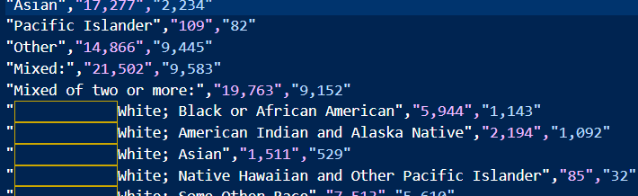
Data Acquisition
Download the Census and NOAA Data
Looked for formatting issues and nulls and duplicates
For example:
Notes:
Mention how it wasn't necessarily difficult retrieving the data, but formatting it correctly to later transform was hard

Slide 5
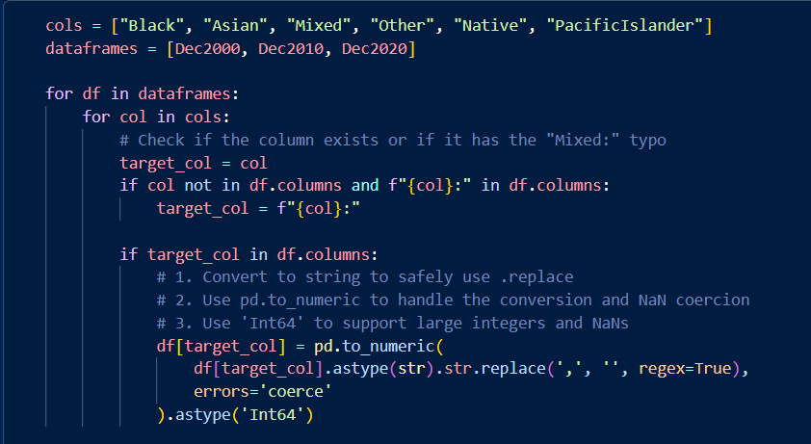
Data Cleaning
Census Data
Transpose
Change from text to int
Add column names and remove first row
Alter column names to remove blank space
NOAA Climate Data
Drop duplicates
Drop nulls
Notes:
Forgot to assign when dropping duplicates
Changing site weather dataframe to have columns with weather code to convert to condition, used to be rows with sites as a column

Slide 6
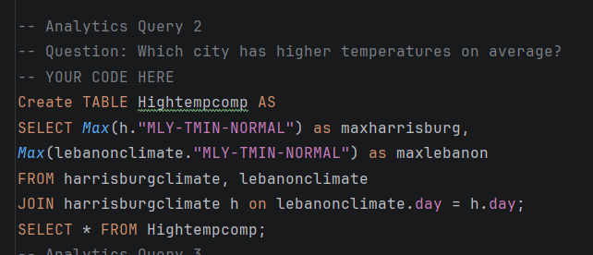

SQL
Tables were created for queries to better use metabase
4 queries were made
Later graphs and maps were created based on the queries
Notes:
Foreign keys were difficult to create, with code using case end to assign foreign key.
How many launches went to each destination?
How do crewed vs. robotic missions compare in payload and destination?
Which agency has the best launch success rate?

Slide 7
Data Visualization
Data Visualization is based on chosen queries done in PostgresSQL Metabase for better visualization for the created query tables
Maps were created using geopandas to accompany other visualization types

Slide 8
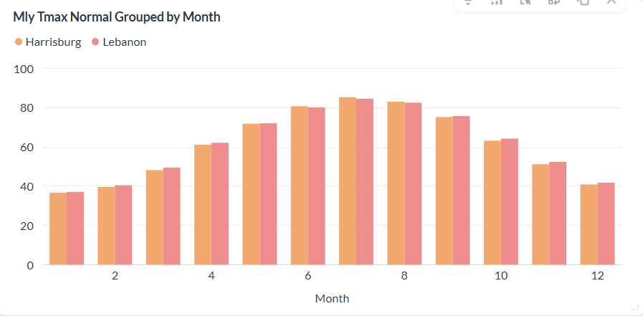
Maximum in temperature By months
Previous SQL Query and Metabase to Visualize

Slide 9
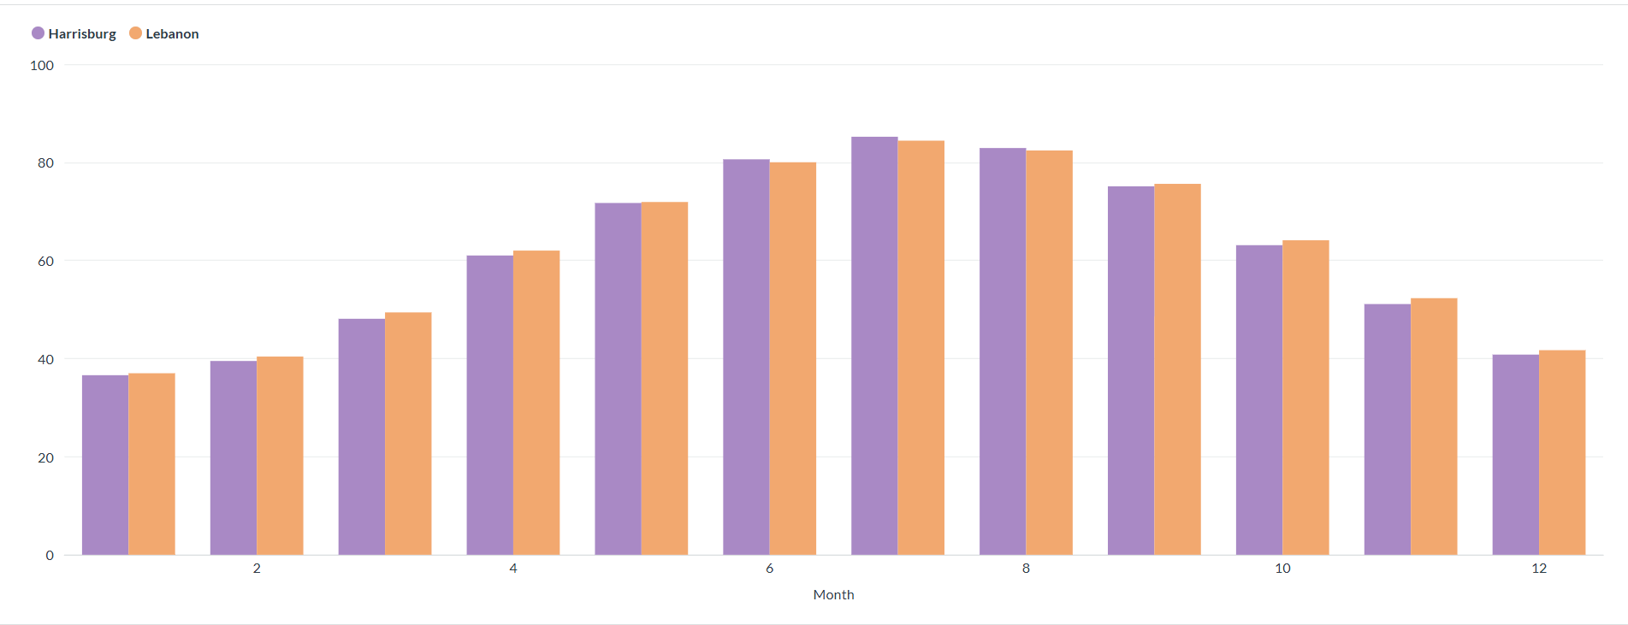
Averages in temperatureBy month
Previous SQL Query and Metabase to Visualize

Slide 10
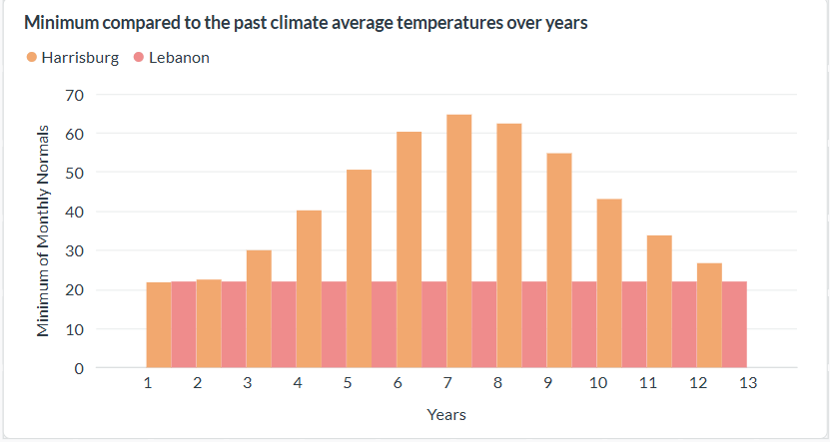
Minimum temperatures By Month
Previous SQL Query and Metabase to Visualize

Slide 11

Anomalies
Anomalies are higher in Harrisburg
Previous SQL Query and Metabase to Visualize

Slide 12
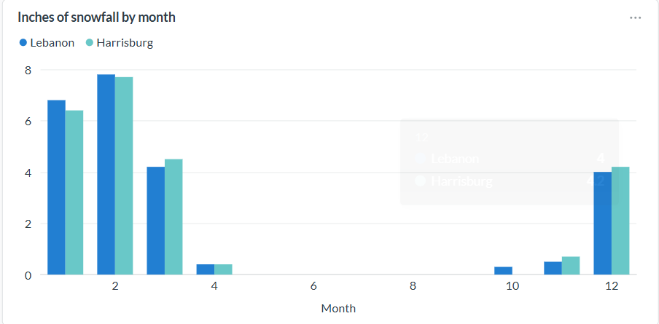
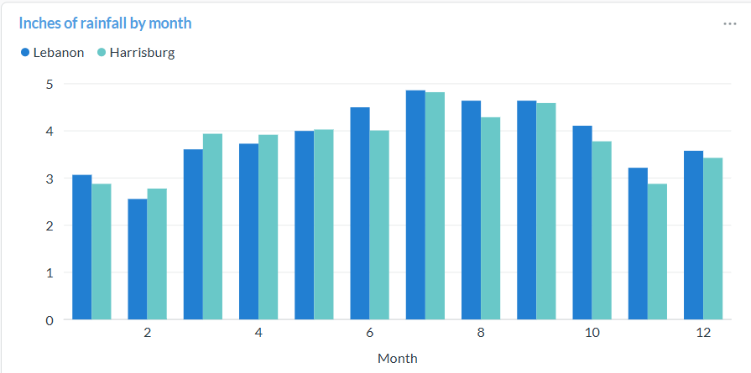
Beyond Temperature: Climate Variables By Month
Metabase to Visualize

Slide 13
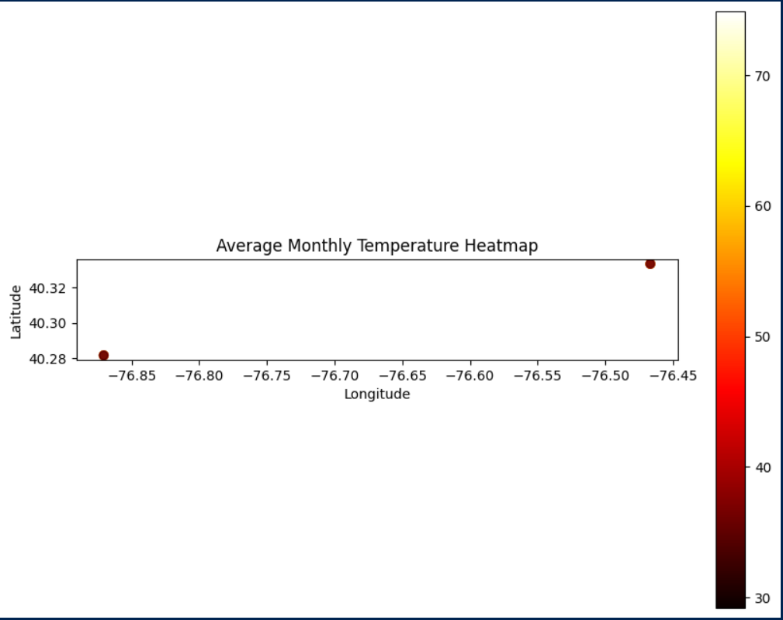
Heatmap
Average monthly temperature is very similar
Previous SQL Query and Metabase to Visualize

Slide 14
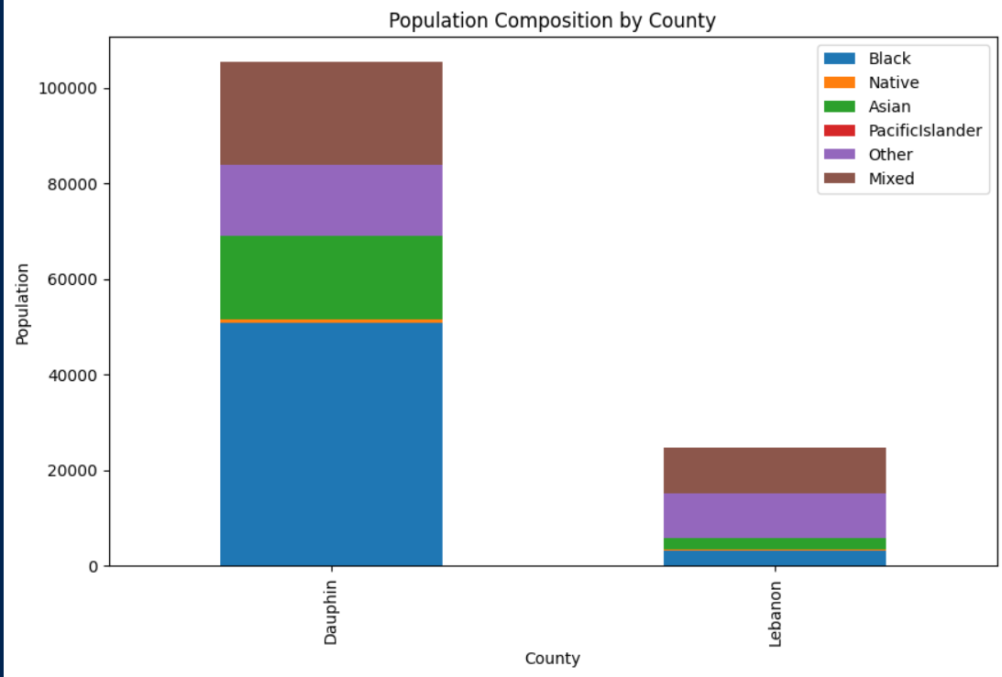
Which city has a larger community of color?
Dauphin County has a much higher community of color in all populations
Previous SQL Query and Python to Visualize

Slide 15
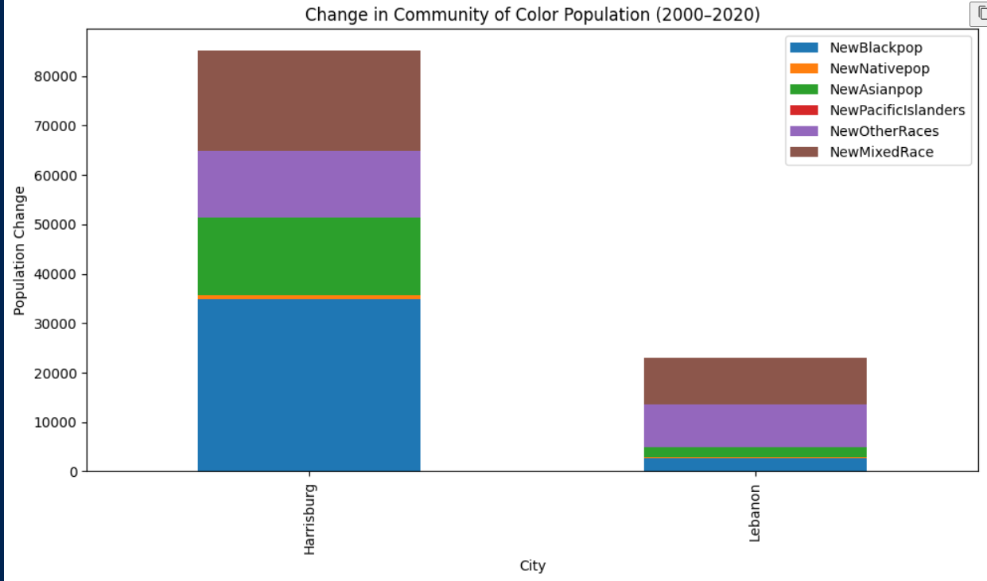
does this change over time?
Community of color over time has changed more in at Dauphin County
Previous SQL Query and Python to Visualize

Slide 16
Consideration for the future:
I would have like to figure out to combine of census data throughout the years
I would have liked to do more of the major cities of Pennsylvania
Utilized shapefiles or raster.
I would have like to gather more geographic data to create a map
Required more than 2 geographic markers
What would be done with more time?
What would be changed if I started over?

Slide 17
Consideration for the future:
Geopandas
To create a proper map using geopandas you need 3 or more points
Metabase
Bar graphs were a challenge due to the format of final data
What was learned?

Slide 18
Citations
Harrisburg-Lancaster-Lebanon-York, PA DMR - select your maps. MarketMAPS. (n.d.). https://www.marketmaps.com/dmr-maps/harrisburg-lancaster-lebanon-york-pa.aspx
Li, D., & Bou-Zeid, E. (2013). Synergistic interactions between urban heat islands and heat waves: The impact in cities is larger than the sum of its parts. Journal of Applied Meteorology and Climatology, 52(9), 2051–2064. https://doi.org/10.1175/jamc-d-13-02.1
Mapmaker: Redlining in the United States. Education. (n.d.). https://education.nationalgeographic.org/resource/mapmaker-redlining-united-states/
Mirzaei, P. A., & Haghighat, F. (2010). Approaches to study urban heat island – abilities and limitations. Building and Environment, 45(10), 2192–2201. https://doi.org/10.1016/j.buildenv.2010.04.001

Slide 19
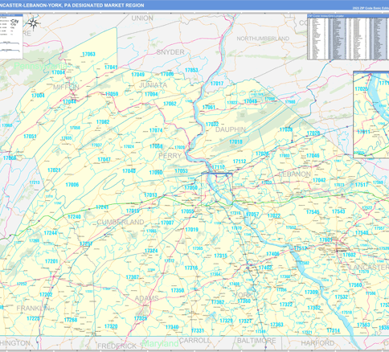
Thank You
Any Questions?
Diazj2@etown.edu

